Slide 1









Bio
Ph.D. in Marketing (University of Georgia)
M.S. in Statistics (University of Georgia)
M.S. in Artificial Intelligence (University of Georgia)
Current Position: J.B. Hoskins Professor of Marketing (Texas Tech University), Associate Dean, Director of Leadership Program.
Previous Teaching Experience: Forecasting, Artificial Intelligence in Business, Marketing Research, International Marketing, Personal Selling, Marketing Analytics.

Slide 2

Smoothing-Based Methods
0
Prof. Mayukh Dass
Forecasting Analytics

Slide 3
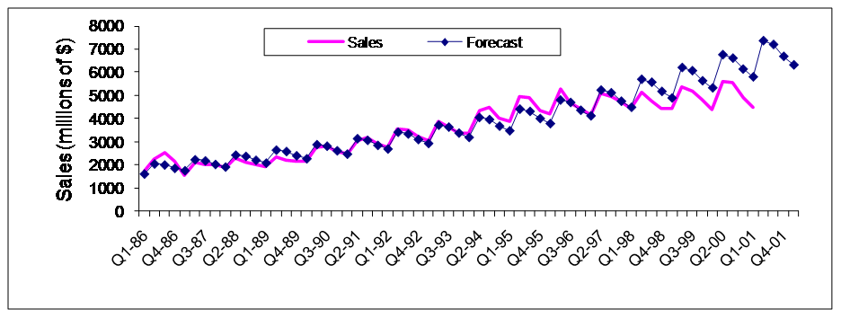
Regression-based model for Coca-Cola Sales: What happens after 1998? Why?
0

Slide 4
Smoothing methods are useful for
0
Data visualization
Removing seasonality and computing seasonal indexes
Forecasting

Slide 5
Example: Coca Cola Sales
0
Coca Cola smoothing.xls contains quarterly sales of Coca Cola (in millions of $) from Q1-86 to Q2-96
Possible Goals:
Time series forecasting: create forecasts for the next 4 quarters
Time series analysis: quantify the components (patterns and noise)

Slide 6
Components of a Time Series - Recap
0
Level (always present)
Trend: steady increase/decrease over time.
Seasonality: pattern that repeats itself every season
Random noise (always present)
Notes:
Level: A “local average”, where the series would be at each point in time if the other effects are eliminated.

Slide 7
Reminder: Modeling Principles
0
Time series Analysis
Reasonableness and parsimony
Goodness of fit (residual analysis)
Time series Forecasting
Forecast accuracy
Parsimony and reasonableness

Slide 8
Moving Averages
0
Visualizing, Forecasting & Computing seasonal indexes

Slide 9
The Moving Average Method
0
The Idea:
Forecast future points by using an average of several past points
Uses
Time series visualization
Computing seasonal indexes
Forecasting
Advantages: Simple, popular
Key concept: width of window

Slide 10
Two types of windows
0
Centered moving average: based on a window centered around time t
Trailing moving average: based on a window from time t and backwards

Slide 11
Computing a Trailing MA
0
Choose window width (W)
For MA at time t, place window on time points t-W+1,…,t
Compute average of values in the window:
W=5
t-4 t-3 t-2 t-1 t

Slide 12
Computing a Centered MA
0
Compute average of values in window (of width W), which is centered at t
Odd width: center window on time t and average the values in the window
Even width: take the two “almost centered” windows and average the values in them
W=4
W=4
W=5
t-2 t-1 t t+1 t+2

Slide 13
Moving Averages for visualizing time series

Slide 14
0
A time-plot of the moving averages can help reveal the LEVEL and TREND of a series, by filtering out the seasonal and random components

Slide 15
For data visualization, which MA is more useful?
0
Centered MA
Trailing MA
1 | 2 | 3 | 4 | 5 | 6 | 7 | 8 | 9 | 10 | 11 | 12 | 13 | 14 | 15 | 16 | 17 | 18 | 19 | 20
21 | 22 | 23 | 24 | 25 | 26 | 27 | 28 | 29 | 30 | 31 | 32 | 33 | 34 | 35 | 36 | 37 | 38 | 39 | 40

Slide 16
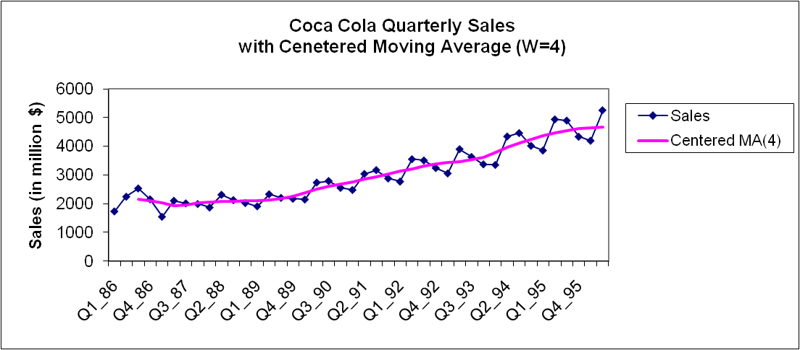
Visualizing Coca Cola Sales via MA chart (W=4)
Excel: Chart Tools > Layout > Analysis> Trendline

Slide 17
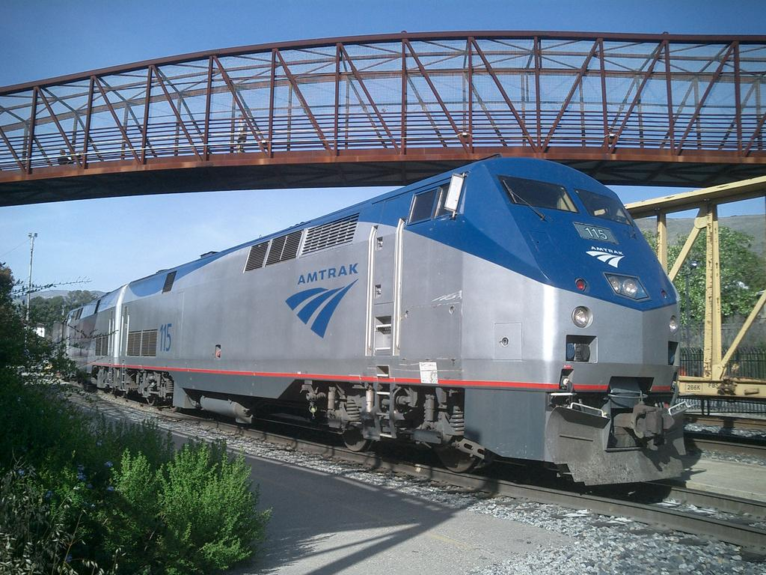
Example: Ridership on Amtrak Trains
US Railway company
Monthly ridership, Jan 1991 to Mar 2004 (Amtrak.xls)

Slide 18
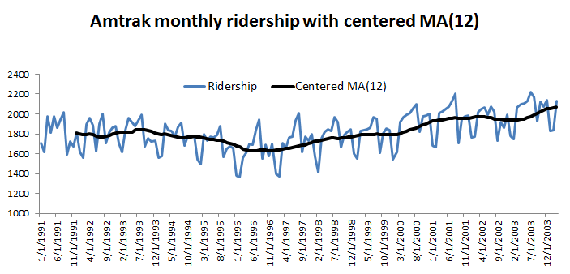
Visualizing Amtrak Ridership via MA chart (W=12)
Excel: Chart Tools > Layout > Analysis> Trendline

Slide 19
Choosing Window Width (W)
0
Balance over- and under-smoothing
If no seasonality, use narrow window (under-smoothing)

Slide 20
For a seasonal series, what window width to use?
0
Smaller than the # seasons
Larger than the # seasons
Equal to the number of seasons
1 | 2 | 3 | 4 | 5 | 6 | 7 | 8 | 9 | 10 | 11 | 12 | 13 | 14 | 15 | 16 | 17 | 18 | 19 | 20
21 | 22 | 23 | 24 | 25 | 26 | 27 | 28 | 29 | 30 | 31 | 32 | 33 | 34 | 35 | 36 | 37 | 38 | 39 | 40

Slide 21
Forecasting with moving averages

Slide 22
0
To forecast a series at time t+k, use a trailing MA that ends at time t:
Notes:
When there is no trend nor seasonality.

Slide 23
An MA is a suitable forecaster for (choose one or more)
0
a long time series
a series with no trend
a series with no seasonality
1 | 2 | 3 | 4 | 5 | 6 | 7 | 8 | 9 | 10 | 11 | 12 | 13 | 14 | 15 | 16 | 17 | 18 | 19 | 20
21 | 22 | 23 | 24 | 25 | 26 | 27 | 28 | 29 | 30 | 31 | 32 | 33 | 34 | 35 | 36 | 37 | 38 | 39 | 40
Notes:
2 and 3

Slide 24
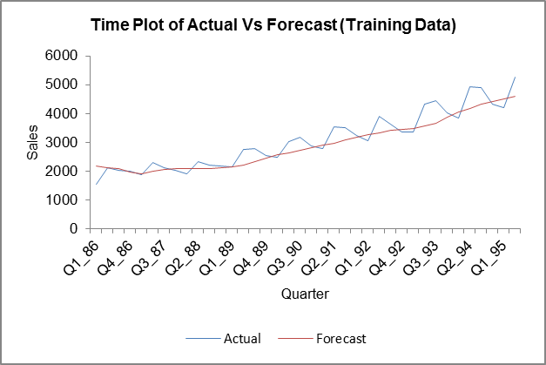
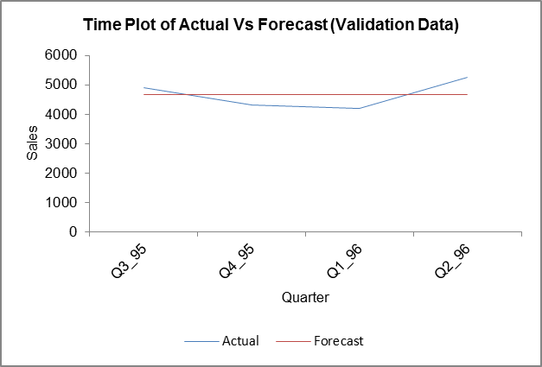
Example: Coca Cola Sales with W=4
MASmoothingOutput1
0
Time Series> Smoothing> Moving Average

Slide 25


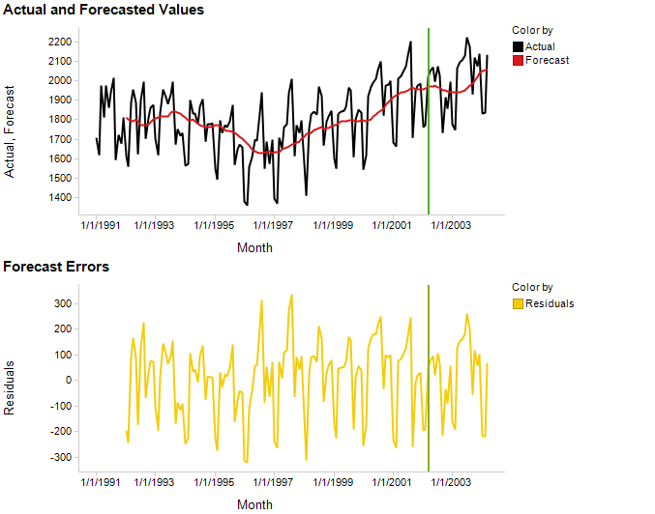
Example: Amtrak Ridership with W=12 Validation = last 3 years (Spotfire for charts)
0

Slide 26
Forecasting with Exponential Smoothing
0

Slide 27
Types of Exponential Smoothing
0
Simple exp smoothing (for series with no trend or seasonality)
Holt’s method (with trend, no seasonality)
Winter’s method (with trend & seasonality)

Slide 28
Simple Exponential Smoothing
0
Assumption: Series has only level (L_{t}) and noise.
Noise is unpredictable ; Level will “stay put”
Forecasts = estimated level at most recent time point: F_{t+k} = L_{t}
Adaptive algorithm: adjusts most recent forecast (or level) based on the actual data: F_{t} = αY_{t} + (1-α) F_{t-1}
α = the smoothing constant (0<α≤ 1)
Initialization: F₁ = L₁ = Y₁
L_{t} = αY_{t} + (1-α) L_{t-1}

Slide 29
Why is it called “Exponential Smoothing”?
0
The formula: L_{t} = αY_{t} + (1-α) L_{t-1}
Substitute L_{t} with its own formula:
Weights decrease exponentially into the past! (compare to MA)
L_{t} = αY_{t} + (1-α)[ αY_{t-1} + (1-α) L_{t-2}] =
= αY_{t} + α (1-α)Y_{t-1} + (1-α)² L_{t-2} = …
= αY_{t} + α (1-α)Y_{t-1} + α (1-α)² Y_{t-2} +…

Slide 30
Another way of viewing it: An adaptive learning process
0
The formula: L_{t} = αY_{t} + (1-α) L_{t-1}
F_{t+1} = L_{t} = L_{t-1} + α (Y_{t} - L_{t-1} )
= F_{t} + α (Y_{t} - F_{t} )
= F_{t} + α E_{t}
update previous forecast
By an amount that depends on the error in the previous forecast
α controls the degree of “learning”

Slide 31
The Smoothing Constant α
0
α determines how much weight is given to the past
α=1: past observations have ___ influence over forecasts (under-smoothing)
α→0: past observations have large influence on forecasts (over-smoothing)
Selecting α
“Typical” values: 0.1, 0.2.
Trial & error: effect on visualization
Minimize RMSE or MAPE of training data
no

Slide 32
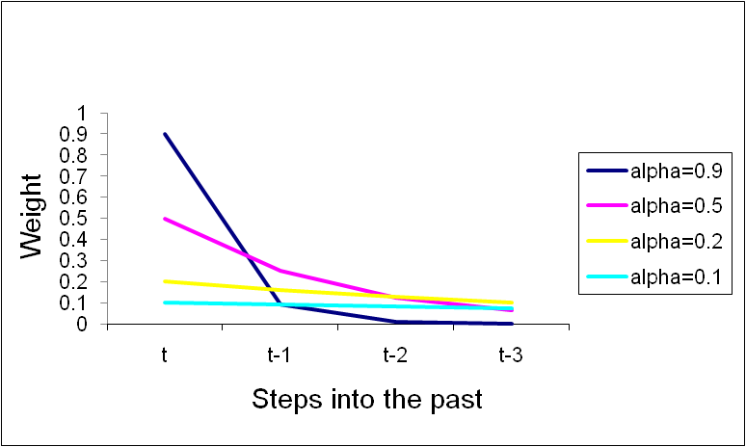
“Feeling” the Effect of α
0
α | α (1- α) | α(1- α)² | α(1- α)³
0.9 | 0.09 | 0.009 | 0.0009
0.5 | 0.25 | 0.125 | 0.0625
0.2 | 0.16 | 0.128 | 0.1024
0.1 | 0.09 | 0.081 | 0.0729

Slide 33
The Beauty of the Method
0
Although forecasts take into account all previous observations, we only need to store the last forecast and most recent observation!
Unlike MA, gives more weight to more recent observations
Simple to understand

Slide 34
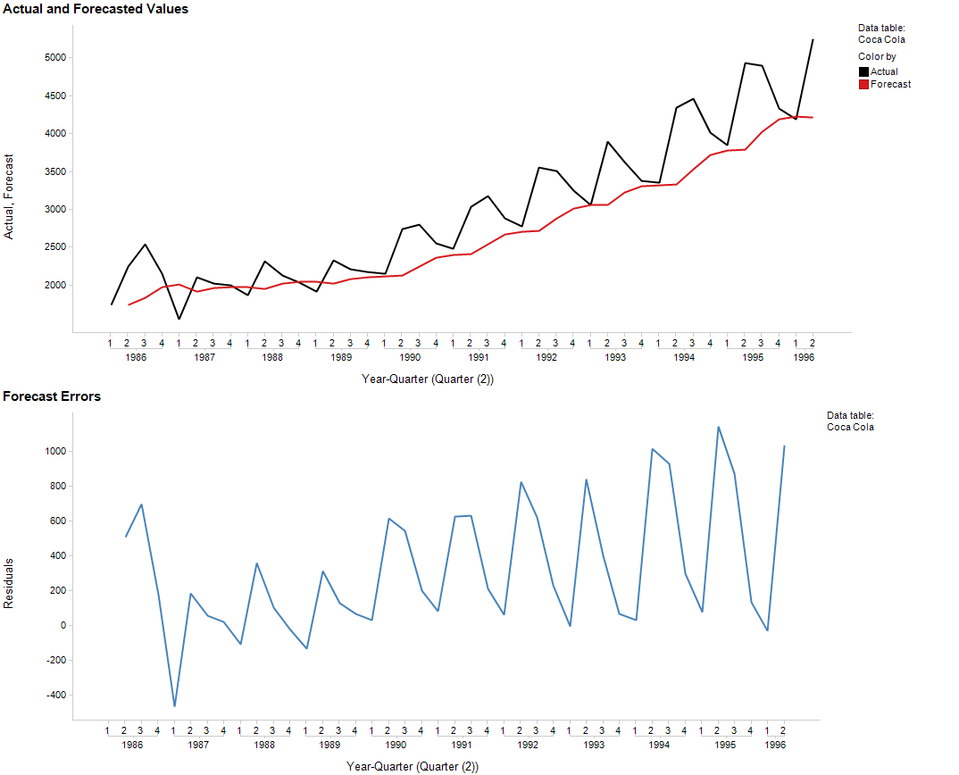
Example: Coca Cola Sales
ExponentialOutput1
0
XLMiner: Time Series >Smoothing > Exponential smoothing
Default: α=0.2
F_{t+1} = F_{t} + α E_{t}

Slide 35


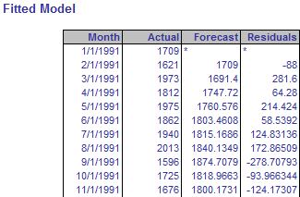
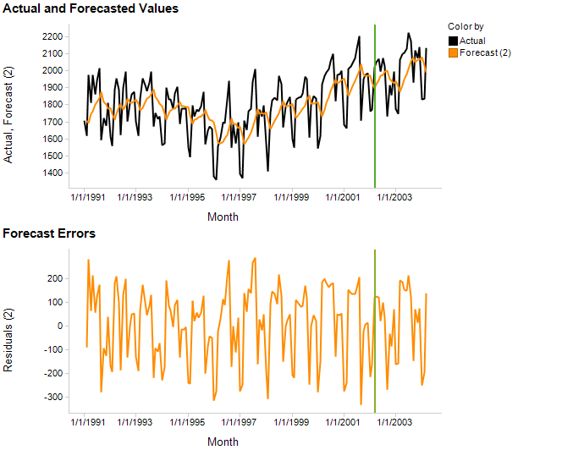
Example: Amtrak Ridership (α=0.2)
0
F_{t+1} = F_{t} + α E_{t}

Slide 36
Session 6 Recap
0
Data Driven forecasting models
- Naïve Forecast
- Moving Average (Centered and Trailing Moving Average) (Window width is the key to success)
- Exponential Models (Learning constant (alpha) is the key to success)
- Assumes no Trend or Seasonality

Slide 37
Removing trend and/or seasonality
Moving averages and exponential smoothing for series with trend and/or seasonality…

Slide 38
Approach 1: Regression
To remove trend and/or seasonality, fit a regression model with trend and/or seasonality
The series of forecast errors should be de-trended and de-seasonalized

Slide 39
Recall Amtrak example
Amtrak-Regression.xlsx, worksheet MLR_Output5

Slide 40
Approach 2: Differencing
Differencing means taking the difference between two observations
Differencing is a simple and popular operation for removing a trend and/or seasonality from a time series
Lag-1 difference: y_{t} – y_{t-1}
for removing trend
Lag-M difference: y_{t} – y_{t-M}
for removing seasonality with M seasons
Double-differencing: difference the differenced series

Slide 41
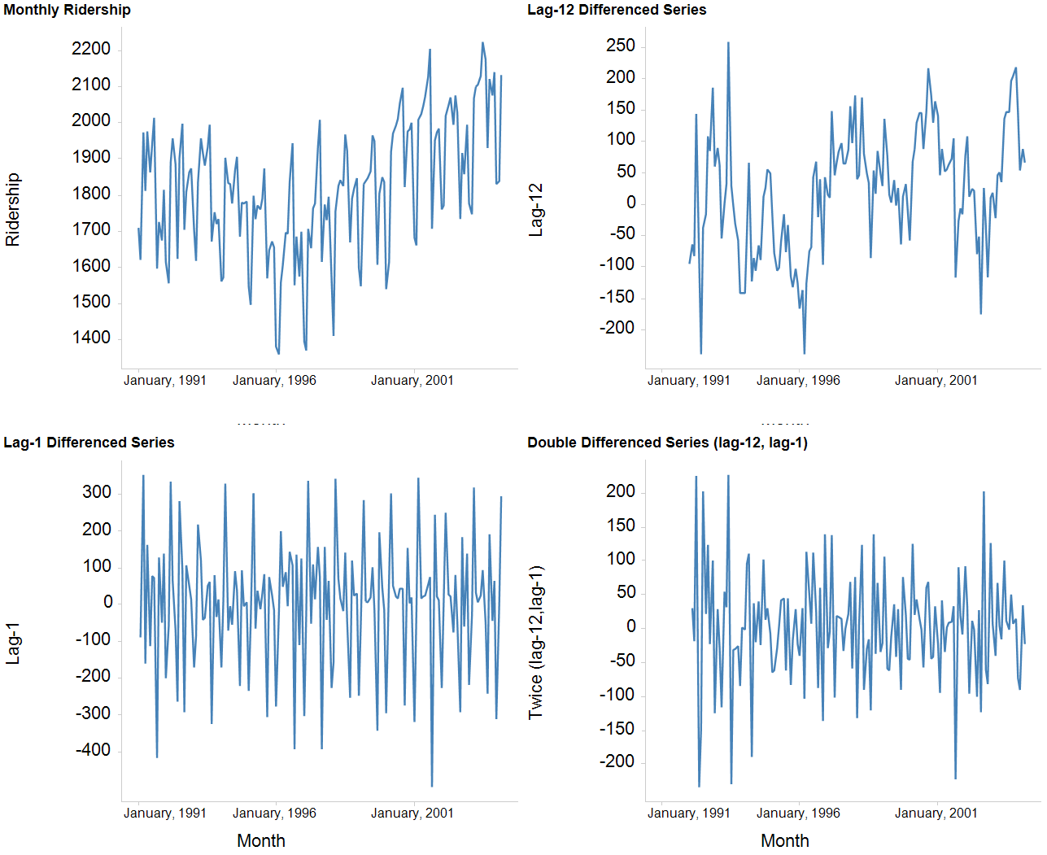

Slide 42
Compared to residuals from regression with trend -- differencing is useful for removing a local/changing trend shape
Differencing is a simple and popular operation for removing a trend and/or seasonality from a time series

Slide 43
Removing Seasonality via Moving averages (and computing seasonal indexes)

Slide 44
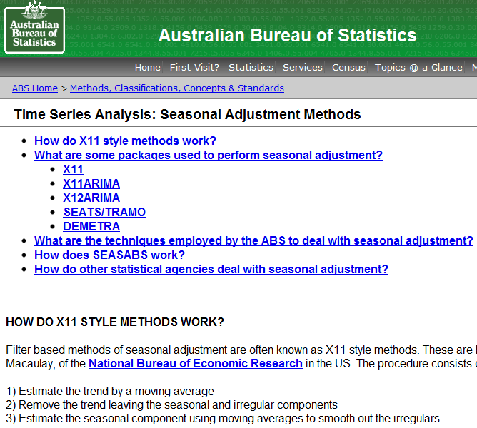
Approach 3: Ratio-to-moving-average method
Uses moving average to remove seasonality
Also generates seasonal indexes as a byproduct

Slide 45
What are seasonal indexes?
0
For a series with M seasons:
S_{j} = seasonal index for the j^{th} season
indicates the exceedance of Y on season j above/below the average of Y in a complete cycle of seasons
Example: Daily sales at ISB café show that Friday has a seasonal index of 1.20 and Monday has an index of 0.70.
Meaning: Friday sales ___% higher than the weekly average, and Monday sales ___% lower than the weekly average sales.
Average of the M seasonal indexes is __ (they must sum to __ ).
20
30
1
M

Slide 46
An Algorithm for Computing the Seasonal Indexes (S₁, S₂, . . , S_{M})
Sheet1
0
Construct the series of centered moving averages of span M.
For each t, compute the raw seasonals = Y_{t} / MA_{t}
S_{j} = average of raw seasonals belonging to season j (normalize to ensure that seasonal indexes have average=1)

Slide 47
Using Seasonal Indexes to De- and Re-Seasonalize
0
De-seasonalized (=seasonally-adjusted) series:
If done appropriately, de-seasonalized series will not exhibit ____________
If so, examine for trend and fit a model
This model will yield de-seasonalized forecasts
Convert forecasts by re-seasonalizing, i.e. multiply them by the appropriate seasonal index
DSY_{t} = Y_{t} / appropriate seasonal index
seasonality

Slide 48
The seasonally-adjusted sales for Q1-86 are in the range
0
$1500-$1700 (million)
$1700-$1800 (million)
$1800-$1900 (million)
$1900-$2000 (million)
1734.83 / 0.8785 = $1974.8 mil
1 | 2 | 3 | 4 | 5 | 6 | 7 | 8 | 9 | 10 | 11 | 12 | 13 | 14 | 15 | 16 | 17 | 18 | 19 | 20
21 | 22 | 23 | 24 | 25 | 26 | 27 | 28 | 29 | 30 | 31 | 32 | 33 | 34 | 35 | 36 | 37 | 38 | 39 | 40

Slide 49
In summary: De-seasonalizing and de-trending for forecasting
Forecasting a series with seasonality and/or trend using MA or exponential smoothing:
De-trend and/or de-seasonalize
Forecast

Slide 50

Reminders
Project Proposal due on April 2

